Slide 1

Coding Style and Synthesis Considerations Ehsan Yazdian

Slide 2
Suggested Coding Style
Modular Design
Break larger designs into modules.
Write one module per file, and name the file the same as the module.
Always use formal port mapping of sub-modules.
Use meaningful names for signals, variables, and modules.
Commenting
Only you know what is in your head.
You need to be able to explain your design by putting comments in your code.
Two types:
Short comments (single line)
// This is a comment
Long comments (Multiple lines)
/* This a multiple
line comment
in Verilog */

Slide 3
Employing Parameters
Use parameters for commonly used constants.
In Signal processing applications it is better to define width of variables as parameters, so that they can be easier optimized.
Example:
module add_mult #(parameter n=7) (
input clk,
input [n:0] a,
input [n:0] b,
output reg [n+1:0] ab_add,
output reg [2*n+1:0] ab_mult
);
always @(posedge clk)
ab_add<=a+b;
always @(posedge clk)
ab_mult<=a*b;
endmodule

Slide 4
Coding Styles
Use assign statements for simple combinational logic and level sensitive always block for complex combinational Logic.
Remember that these to codes describe similar circuits:
assign a=b+c; always @(b or c)
a=b+c;
Multiple continuous assignments (assign) to a single net in NOT allowed.
assign a=b+c;
assign a=b*c;

Slide 5
Coding Styles
Do not mix blocking and non‐blocking assignments in an always block.
Do not mix edge and level sensitive elements together.
always @(posedge clk or a)
It is better (not necessary) to avoid mixing positive‐edge and negative‐edge triggered flip‐flops (clk) in one design
Confuses the timing closure
Multiple procedural assignments (inside an always block) to a single variable is allowed.
The last assignment is evaluated.
always @(posedge clk) begin
ab_add <= a+b;
ab_mult <= a*b;
ab_add <= 2*(a+b);
end

Slide 6
Coding Styles
Multiple procedural assignments in different always blocks to a single variable is NOT allowed.
ERROR:HDLCompiler:1401 - "D:\...\test.v" Line 29: Signal ab_mult[14] in unit add_mult is connected to following multiple drivers:
Be careful to create correct sensitivity lists.
Remember that synthesizer automatically completed the incomplete sensitivity list in a combinational always block!!!
WARNING:HDLCompiler:91 - "D:\...test.v" Line 30: Signal <b> missing in the sensitivity list is added for synthesis purposes. HDL and post-synthesis simulations may differ as a result.
always @(posedge clk)
begin
ab_add<=a+b;
ab_mult<=a*b;
end
always @(posedge clk)
ab_mult<=2*a*b;
always @(a)
ab_add=a+b;

Slide 7
Signed vs. Unsigned Addition
Be careful of signed and unsigned operations.
Especially in signal processing applications always define signed variables..
To multiply signed variables, Verilog-2001 style is more compact.
module add_signed_2001 (
input signed [7:0] A,
input signed [7:0] B,
output signed [8:0] Sum);
assign Sum = A + B;
endmodule
module add_signed_1995_template(
input [3:0] A,
input [3:0] B,
output [4:0] Sum,
output [4:0] Sum_unsigned);
assign Sum_unsigned=A+B;
assign Sum = {A[3],A}+{B[3],B};
endmodule
Example:
A=-3; //4’b1101
B=1; //4’b0001
Sum_unsigned = 14; //5’b01110
Sum = -2; //5’b11110
//if A and B could not be defined signed
module add_carry_signed (
input [7:0] A,
input [7:0] B,
output signed [8:0] Sum);
assign Sum = $signed(A) + $signed(B);
endmodule

Slide 8
Verilog is NOT a Software Programming Languae
Software Programming Language
Language which can be translated into machine instructions and then executed on a compute
Hardware Description Language
Language for modeling the temporal behavior and spatial structure of hardware
Verilog is not C!: You are not writing a computer program, you are describing hardware…
Think Hardware:
Think of the topology implied by the code

Slide 9
Synthesis Considerations
Verilog provides a wide variety of means to express yourself.
Some modules you create, like testbenches, are never intended to be synthesized into actual hardware.
In these types of modules, feel free to use the complete power of Verilog.
For modules you intend to synthesize, you should consider:
Predictability
Efficiency
Synthesizability

Slide 10
Synthesis Considerations
Predictability is important.
Predictability of what hardware may be created by what you describe.
Understanding of your description and how it may map into hardware is important when you are debugging the physical implementation.
Efficiency is important, for both performance and cost concerns.
Use multiplication, division, and modulus operators sparingly.
Especially division eats a lot of LUTs because it could not be implemented on DSP blocks.
Use vectors /arrays to create only small memories and use cores to create large memories.
Case may be better than large if-else trees.

Slide 11
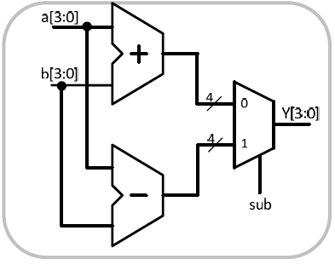
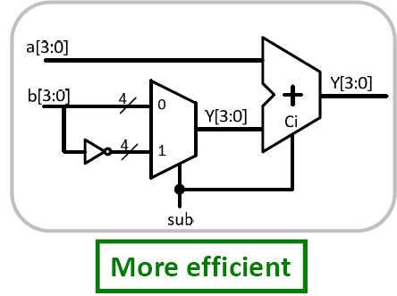
HDL for Synthesis
“Bad” HDL code does not allow efficient optimization during synthesis.
Garbage in, garbage out!
Logic synthesizer doesn’t do magic! designer has to take some responsibility in coding.
Example:
input sub;
input [3:0] a,b;
output [3:0] y;
wire [3:0] tmp;
assign tmp = sub ? ~b : b;
assign y = a + tmp + sub;
input sub;
input [3:0] a,b;
output [3:0] y;
assign y = sub ? (a‐b) : (a+b);

Slide 12
Synthesis Considerations: Synthesizability
Not all Verilog constructs are synthesizable because:
Does not make sense in hardware (e.g. $display)
Not possible to achieve (e.g. delay control like #10)
Too difficult or too abstract for the synthesis software (e.g. A / B)
Synthesizable Constructs
Ports (input, output, inout)
always, if, else, case
assign
parameter
wire, reg
function, task
for, while

Slide 13
Non‐Synthesizable Constructs
delays “#” are ignored by synthesis tools as if it is not there
Events
real (real data type)
time (time data type)
Comparison to X and Z are ignored (e.g., a == 1’bz)
fork join
many of system tasks such as $display, $monitor, $fdisplay, ……

Slide 14
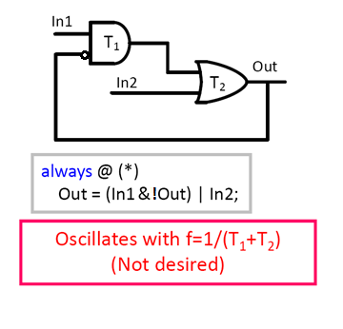
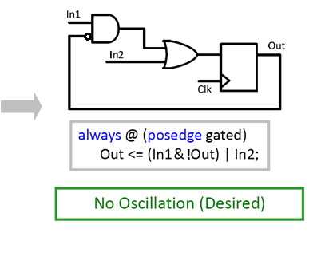

Avoid Timing Loop
Do not use timing loops in the circuit
Timing loop: when an output of a combinational logic loops back to its input
Results in oscillation
Complicated timing analysis
Solution: Add a flip‐flop on the feedback

Slide 15
Standard Templates for Always Blocks
Templates for sensitivity lists:
Synchronous Design:
always @(posedge clk)
Synchronous logic without asynchronous reset.
Use of “negedge clk” is legal
always @(posedge clk or posedge rst)
Synchronous logic with asynchronous reset.
Can use “negedge rst_n” for active low reset.
Combinational Design:
always @(sig_1 or sig_2 or … or sig_n) Or always @(*)
Combinational logic description; whenever an input changes, the output must be evaluated.
Every signal used as an “input” in description must appear in the sensitivity list.
@(posedge clk or posedge rst)
if (rst)
…..
else
.....

Slide 16
Sequential Logic
Sequential logic can only be realized using always blocks.
Consists of :
Flip flops that are normally controlled by:
Positive edge of the clock (posedge) : always @ (posedge Clk)
Negative edge of the clock (negedge) : always @ (negedge Clk)
Any variable assigned a value is the output of a flip‐flop
Latches
Transfers input to output when clock is “1” and stores the value O.W.

Slide 17
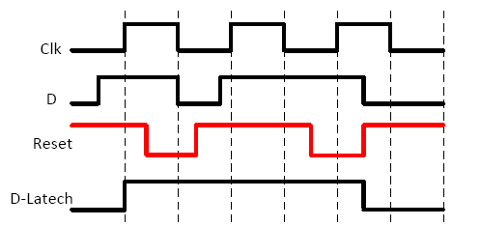
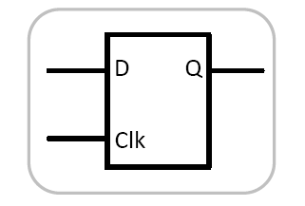
D-Latch
Example:
module Latch(D, Clk, Q);
input D, Clk;
output reg Q;
always @ (D, Clk)
if (Clk)
Q<=D;
endmodule
module Latch(D, Clk, Q);
input D, Clk;
output reg Q;
always @ (Clk)
if (Clk)
Q<=D;
endmodule
Both results in a latch
Results in a Synthesis warning saying D is not in the sensitivity list

Slide 18
Latch Inference in Combinational Logic
Most of the times (maybe more than 99%) latches are generated Unintentionally: unwanted Latch
The latch is inferred when “incomplete” if‐else or case statements are declared.
WARNING:Xst:737 - Found 1-bit latch for signal. Latches may be generated from incomplete case or if statements. We do not recommend the use of latches in FPGA/CPLD designs, as they may lead to timing problems.
This latch is “unwanted” as the logic is combinational not sequential.
To avoid latch inference make sure to specify all possible cases “explicitly”
If there is some logic path through the always block that does not assign a value to the output a latch is inferred

Slide 19
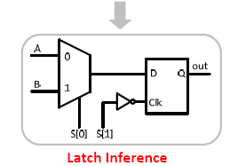
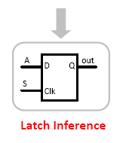
Incomplete If-Else and Case statements
module DUT (A,B,S,out);
input A, B, S;
output reg out;
always @(*)begin
if (S==1)
out = A;
end
endmodule
module DUT (A, B, S, out);
input A, B;
Input [1:0] S;
output reg out;
always @(A, B, S) begin
case (S)
2’b00: out = A;
2’b01: out = B;
endcase
end
endmodule

Slide 20
Solution to Unwanted Latch inference
To avoid latch inference make sure to specify all possible cases “explicitly”
Two practical approaches to avoid latch inference:
For if‐else construct:
Initialize the variable before the if‐else construct
Use else to explicitly list all possible cases
For case constructs:
Initialize the variable before the if‐else construct
Use default to make sure no case is missed!
Do NOT let it up to the synthesis tool to act in unspecified cases and specify

Slide 21
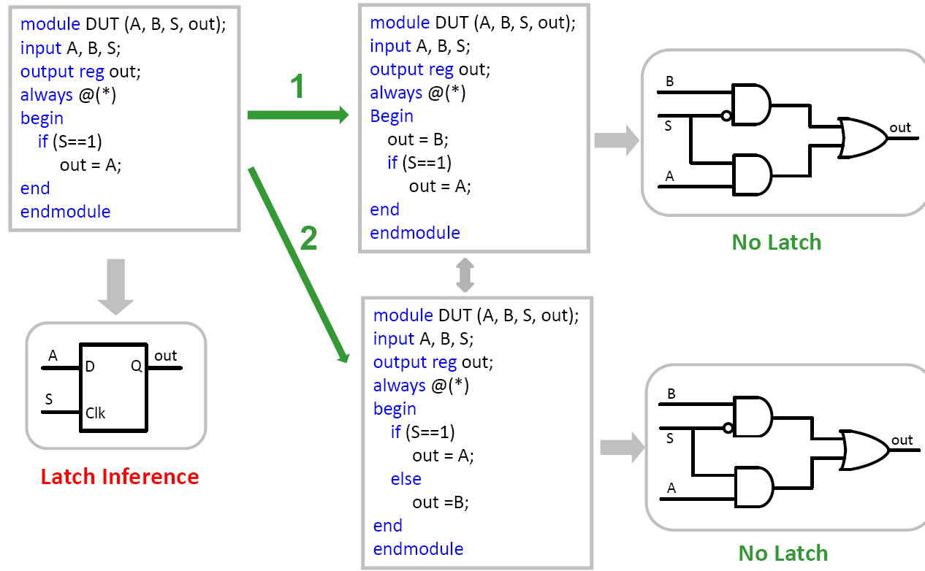
Solutions for If-Else

Slide 22
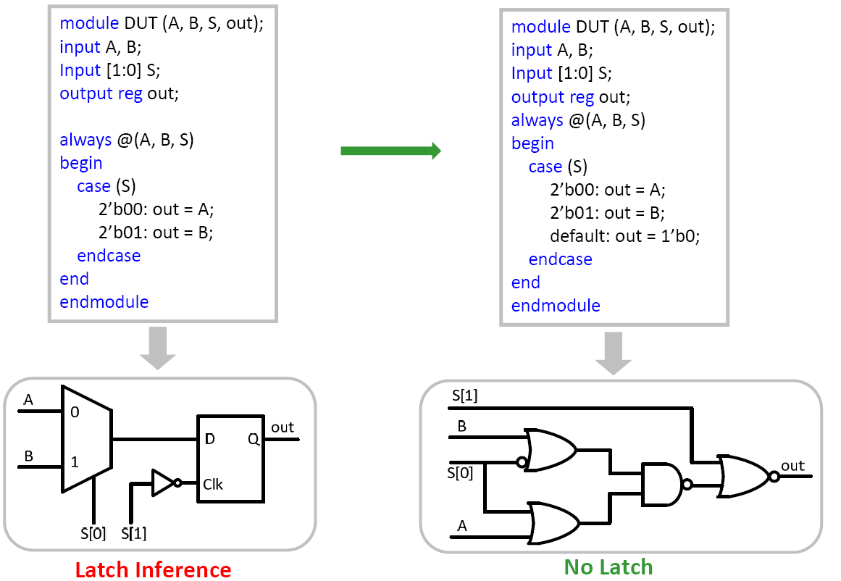
Solutions for Case

Slide 23
Clock Distribution in FPGA
Clock is the most important signal in the design (golden)
Why is it different from other signals?
It is a global signal, i.e., it is routed across all modules in the design
In Xilinx FPGA devices, “global buffer” are employed in the design to drive the clock signals.
Schematic designs use a primitive called BUFG.
HDL designs have two options:
Direct use of instantiated BUFG primitive from library.
Allow synthesis tool to identify wires which are used as clocks and automatically infer BUFG primitives.
No buffering should be done on clock during coding. (Synthesizer will do it)

Slide 24
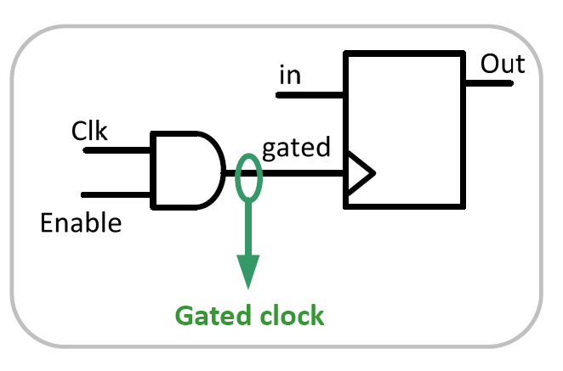
Avoid Gated clock
Definition: Clock that is enabled by an enable signal
Applications:
Used for power saving to switch off part of the chip in fraction of time
Avoid clock gating as much as possible
Clock should be directly connected to flip‐flops without any logic gating
Otherwise, it results in clock skew in the design (undesired!)
A side benefit is that your static timing analysis will be less complicated!
Not a golden signal anymore!

Slide 25
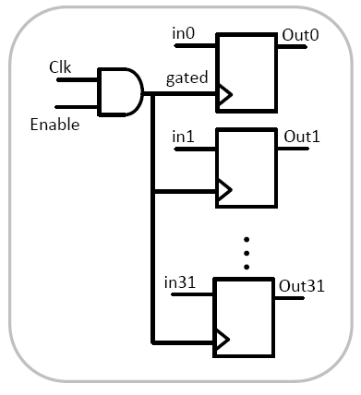
Gated Clock
assign gated = Clk & Enable;
always @ (posedge gated)
Out[31:0] <= In[31:0];
High fan‐out (in this example: Deriving 32 flip flops)
Large delay
high clock skew

Slide 26
Gated clock
Example of a Gated Clock:
assign gated = Clk & Enable;
always @ (posedge gated)
Out <= In;
Use clock enables instead.
always @ (posedge Clk)
if (Enable)
Out <= In;

Slide 27
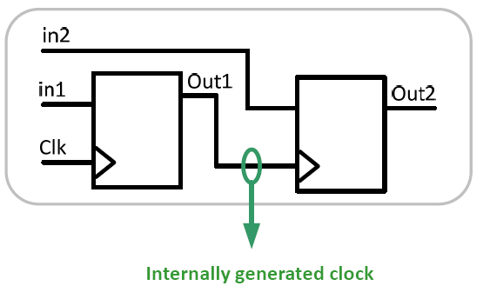
Internally Generated Clocks
Since most FPGA devices have a limited number of these clock distribution resources, it makes sense to minimize the number of unique clocks in your design.
Creating internally generated clocks is recommended only from the DLL/DCM because these elements have dedicated access to the global clock networks that exist in FPGAs.
Do not use internally generated clocks
always @ (posedge Clk)
Out1 <= In1;
always @ (posedge Out1)
Out2 <= In2;
Complicates the timing analysis
Setup time
Hold time
Difficult to deal with during synthesis

Slide 28
Resets
Most designs use another synchronization signal, a “reset”, to put the system in an initial state.
you may not need (or want) to initialize every state element.
Initial state does not need to be all zero or all one, it can be whatever you need.
Reset signals can be synchronous (to the system clock) or asynchronous.

Slide 29
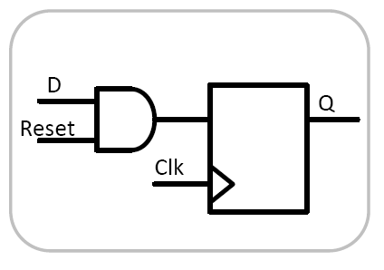
Synchronous Resets
A synchronous reset input to a flip flop has the same timing requirements as other synchronous inputs to the flip-flop.
Example:
always @ (posedge Clk)
if (Reset == 0)
Q<=0;
else
Q<=D;
Issues:
Resources Without Reset: SRL16,...
An optimized FPGA resource will not be used if an incompatible reset is assigned to it. The function will be implemented with generic elements and will occupy more area
Resources With Reset: Mult16,...

Slide 30
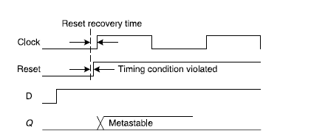
Asynchronous Resets
An asynchronous reset is not synchronized to the clock; when it is asserted, the state element will immediately transition.
Example:
always @ (posedge Clk, posedge Reset)
if (Reset)
Q<=0;
else
Q<=D;
In contrast to a synchronous reset, this reset has a potential problem when de-asserted.
It can occur at any time, even near clock edges.
Skew on the signal distribution can result in different portions of the design “waking up” at different times, sending the design into some state other than what was intended.

Slide 31
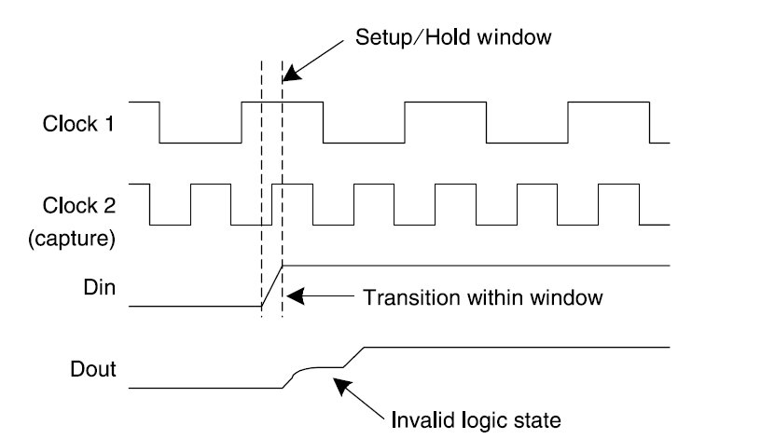
Metastability
If the setup and hold times are violated, a node within the flip-flop can become suspended at a voltage that is not valid for either a logic-0 or logic-1.
The amount of time the output can stay metastable is probabilistic, and it is possible for the output to remain metastable for the entire clock period.

Slide 32
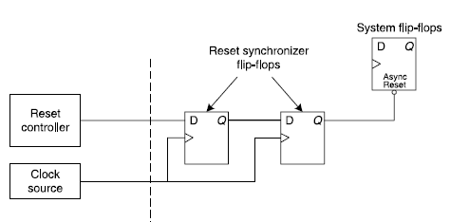
Synchronizing Reset
Fully Synchronization: The best solution to the problem introduced in the preceding slide.

Slide 33
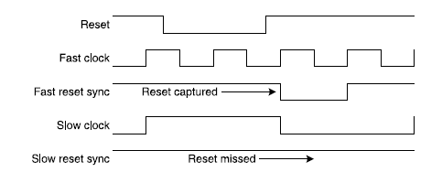
Problem with Slow clock
Fully synchronous resets may fail to capture the reset signal itself (failure of assertion) depending on the nature of the clock.

Slide 34
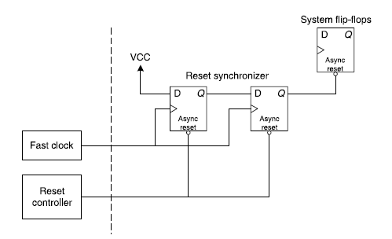
Asynchronous Assertion, Synchronous Deassertion
Interesting circuit to drive asynchronous resets:
Master reset asserts asynchronously, forcing your circuit into a known state immediately.
Master reset de-asserts synchronously, allowing meaningful timing requirements/analysis.

Slide 35
Asynchronous Assertion, Synchronous Deassertion
A reset circuit that asserts asynchronously and de-asserts synchronously generally provides a more reliable reset than fully synchronous or fully asynchronous resets.
module resetsync(
output reg oRstSync,
input iClk, iRst);
reg R1;
always @(posedge iClk or negedge iRst)
if(!iRst) begin
R1 <= 0;
oRstSync <= 0;
end
else begin
R1 <= 1;
oRstSync <= R1;
end
endmodule

Slide 36
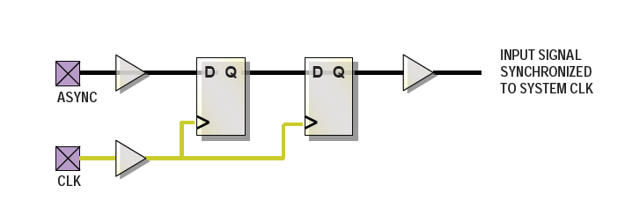
Asynchronous Inputs
Asynchronous inputs, like buttons, switches, and anything not synchronized to the system clock will inevitably cause input setup or input hold violations.
Synchronize signals to system clock using a synchronizer circuit:
Double-flopping: a simple way to minimize the probability of metastability is to use.

Slide 37
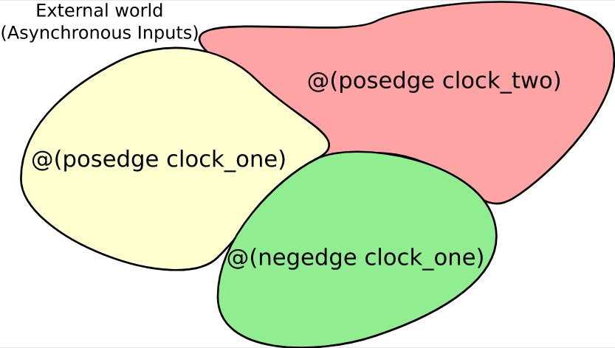
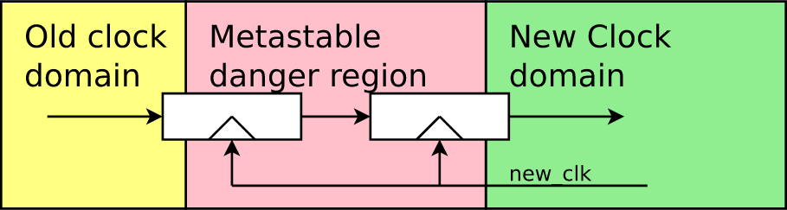
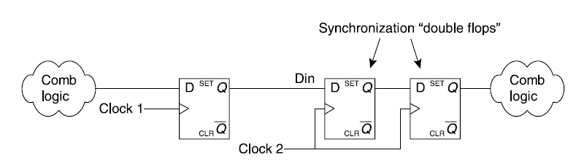
Clock Domain Crossing (CDC)
Double flopping is a technique that can be used when passing single-bit signals between two asynchronous clock domains.

Slide 38
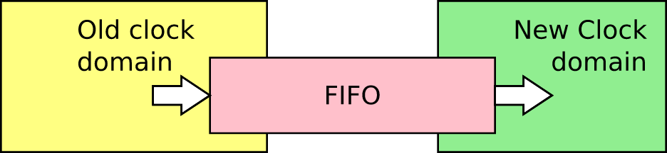
CDC: Sending a stream of values
Double flopping technique, although solve the issue of Metastability, however assume transferring a stream of data, but consider transferring
from 100MHz to 200Mhz: double flopping results in doubling the volume of data. This will occur even if two clocks have a little mismatch.
Vie versa: half of data will be lost.
Asynchronouse FIFO guarantees not to loose nore duplicate a data.
More Useful and interesting information on CDC:
https://zipcpu.com/blog/2017/10/20/cdc.html
http://www.sunburst-design.com/papers/CummingsSNUG2008Boston_CDC.pdf

